Slide 1

백개의 리뷰
: 전자제품 리뷰 총정리 서비스
Team 09
김정국 (데이터사이언스학과)
신성구 (데이터사이언스학과)
이준규 (데이터사이언스학과)
조유진 (데이터사이언스학과)
허상우 (데이터사이언스학과)

Slide 2
Motivation / Background

Slide 3
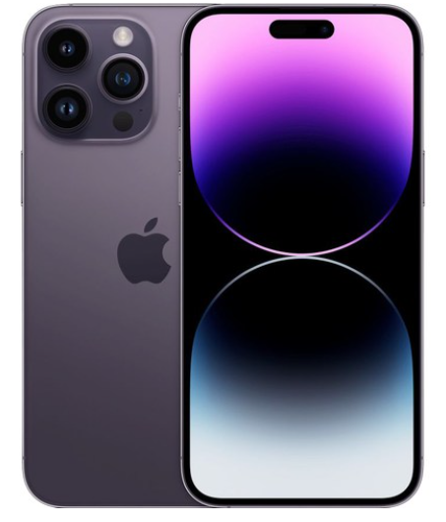
01. Motivation / Background
When purchasing an electronic product,
we take various factors into consideration
Color
Design
Pros
and
cons
Weight

Slide 4
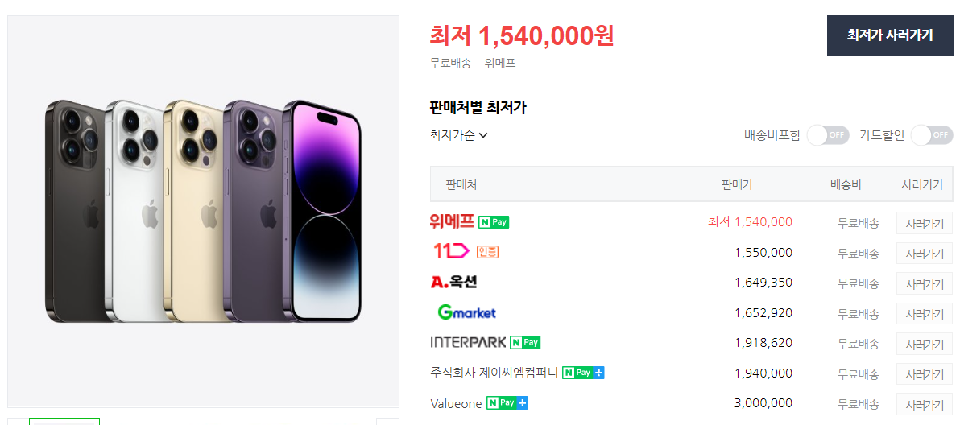
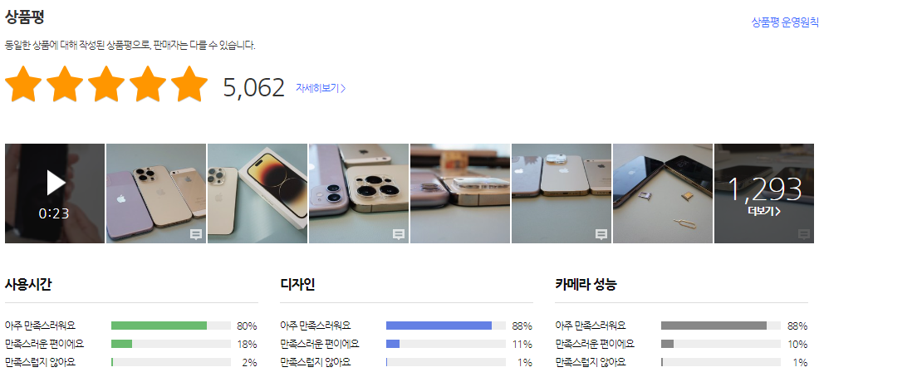
01. Motivation / Background
• The reviews provided by other buyers are very helpful for our consumption decision
Case 1
• However, review data exists
separately for each distribution platform,
and it takes a lot of time to look it up.
• It will be very helpful for consumers to
make decisions if they can see reviews
from different platforms in one setting.
Let's gather all the reviews of each product
in one page and show them!

Slide 5
Project Scenario

Slide 6
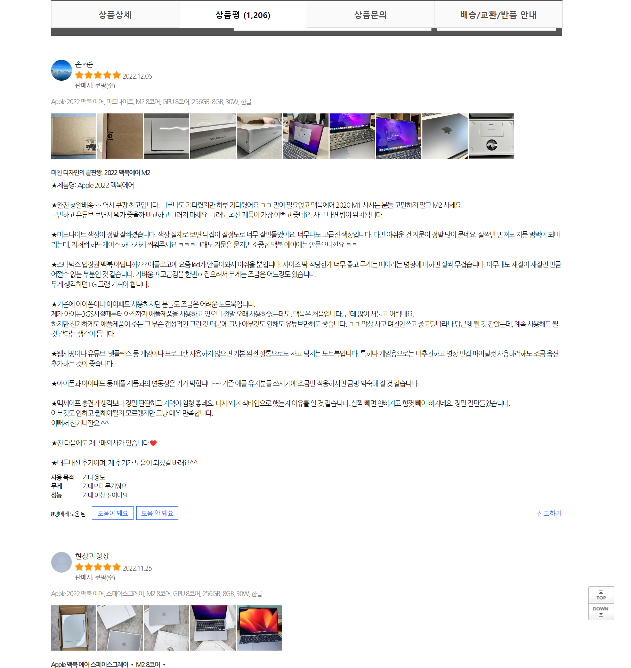



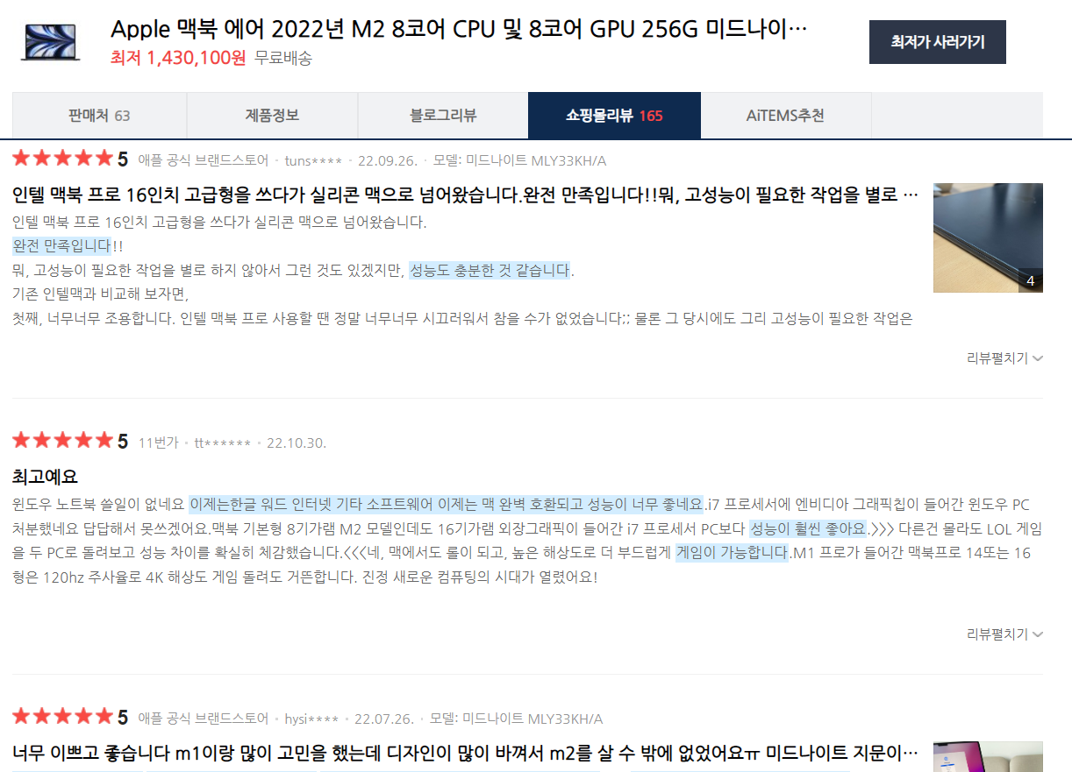


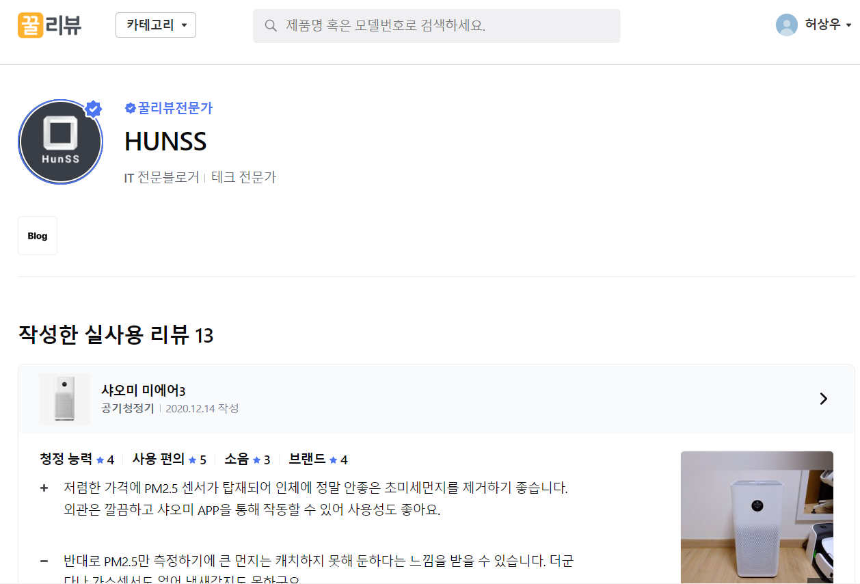

02. Project Scenario - Overview
“Review everywhere everything all at once”
Reviews after Actual Use
Users
• Which product has a lot of recent reviews?
• What is the most mentioned review keyword?
• How to decide on each review to be a positive vs. negative?
• How to minimize the impact of advertising reviews?
Service Goal
etc..

Slide 7

02. Project Scenario - Requirements & Assumptions
Assumptions
🤔
We need a lot of quality reviews, but it is very difficult to collect review data from all different online shopping malls and reviews sites in reality……..
Requirement
😮‍💨
😍
Naver Shopping and Coupang data mainly used for review data collection
1) Using Python to crawl review data
2) Integrating reviews from multiple data sources into a single database and linking them to MySQL
3) Extract the necessary review data from such an integrated DB and use it for wordcloud, positive/negative prediction, and keyword inquiry.
Requirements
✔
Using Python to crawl review data
Integrating reviews from multiple data sources into a single database and linking them to MySQL
Extract the necessary review data from such an integrated DB and use it for Wordcloud, positive/negative prediction, and keyword inquiry.
✔
✔

Slide 8
02. Project Scenario - Technical Challenges
🚨
It was difficult to organize a review database from a web page source code with only a simple code, so we borrowed webscraping models released to the online community such as GitHub.
⌨
As reviews were written freely regardless of grammar, it was difficult to apply grammatical rules to standard preprocessing for NLP..
🤨
It was difficult to extract sentence-unit data because there were many cases where the proper grammar was not used.

Slide 9
Architectural Design

Slide 10
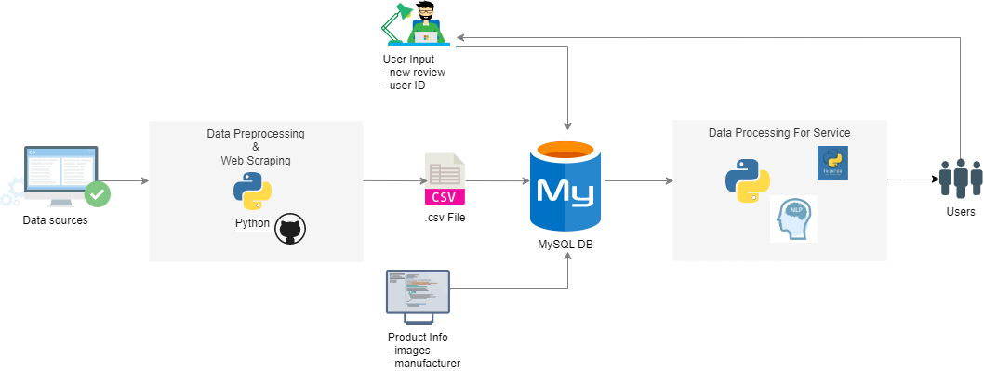




03. Architectural Design
Project Architecture
Data Source
Crawling &
Preprocessing
Database
Processing
Service
User Input
New review
Data time
User ID
Sentimental analysis
Word cloud visualization
Natural Language Processing
• Sentiment Analysis
• WordCloud
UI/UX: TKINTER
Product Info
Image
Manufacturer
…
Keyword classification

Slide 11
CREATE Team 09.DB

Slide 12

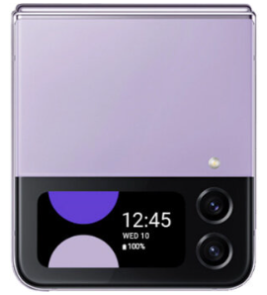
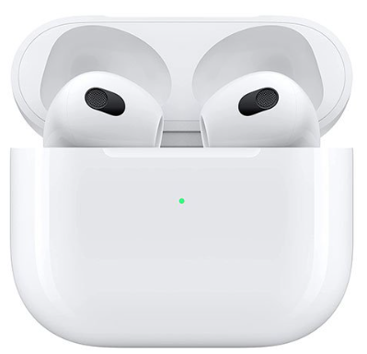
04. Database - Which Products?
Seven products from three manufacturers:
Samsung, LG, and Apple
Five products from two manufacturers:
Samsung and Apple
Four products from two manufacturers:
Samsung and Apple
Data primarily consolidated into a single spreadsheet and saved as csv files, which are then configured to work with MySQL

Slide 13
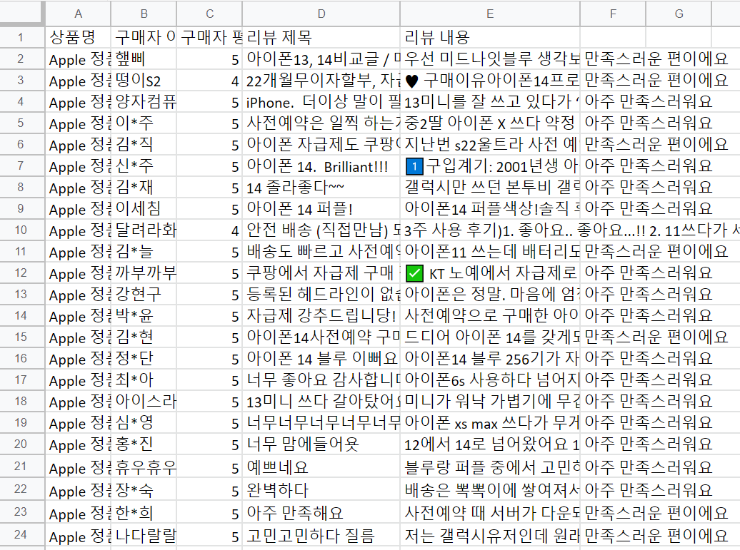
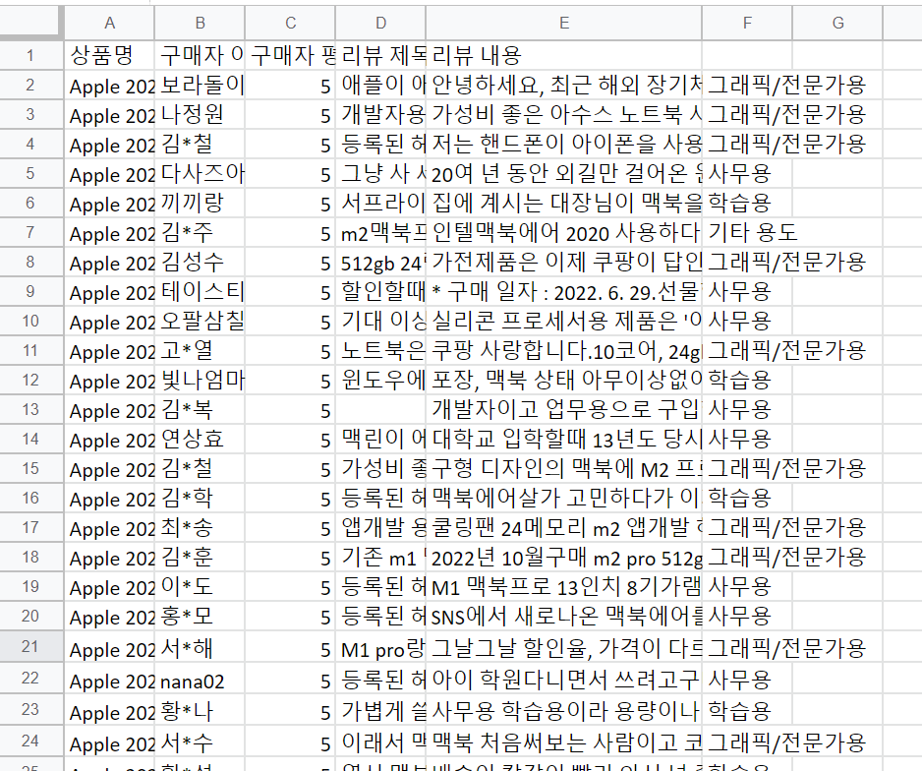
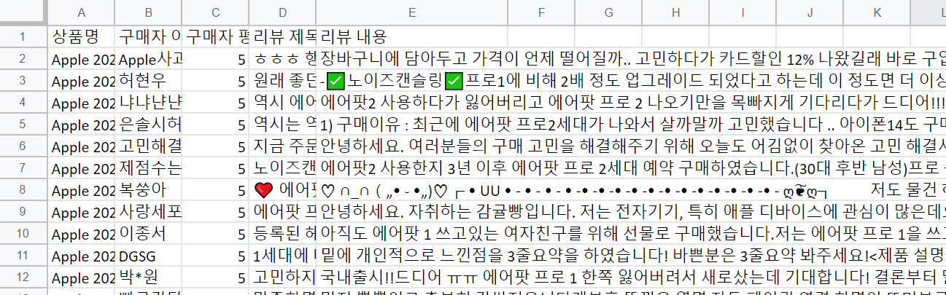
04. CSV Dataset

Slide 14
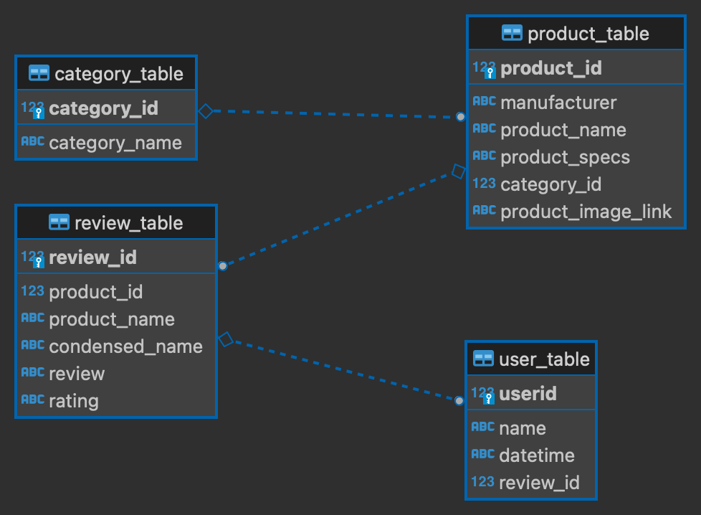
04. MySQL Entity Relationship Diagram
Entity Relationship Diagram of four tables with unique primary keys and foreign keys

Slide 15
Database Workloads

Slide 16
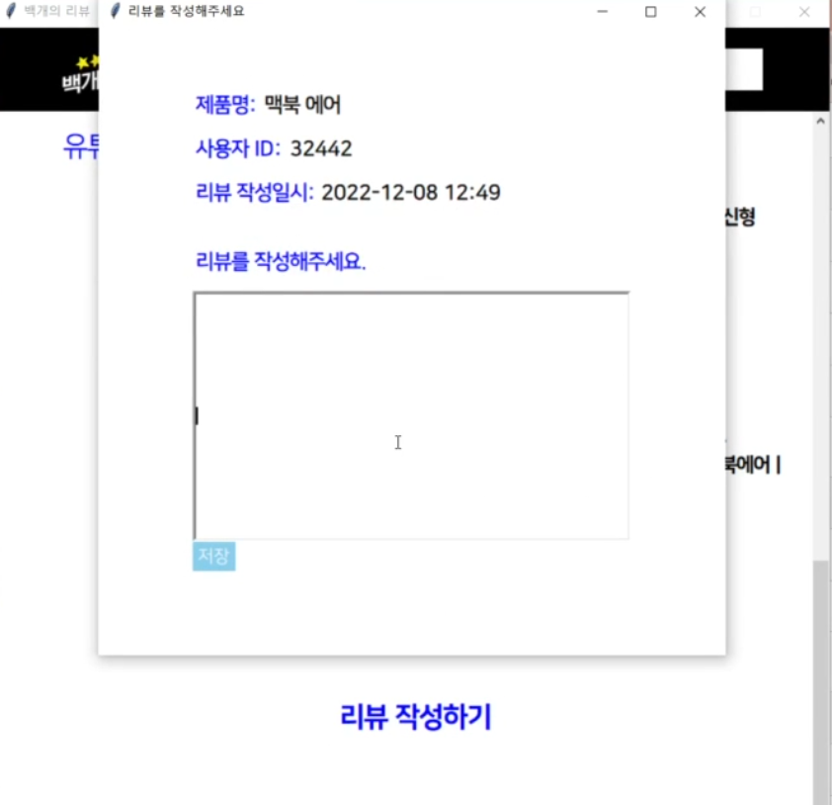
05. Database Workloads
OLTP(Update DB when our user added a new review)
: INSERT INTO user_table, review_table
• INSERT INTO teamdb9.user_table VALUES (35, 'Sangwoo Heo', ‘2022-12-12’, 11074, ‘맥북 에어’);
• INSERT INTO teamdb9.review_table VALUES (7, ’Apple 2022 맥북 에어, 실버, M2 8코어, GPU 8코어, 256GB, 8GB, 30W, 한글’, ‘맥북 에어’, '쿠팡답게 칼배송입이다 미드나잇과 스그중 무엇을 살까 고민하다 미드나잇을 케이스 씌우고 쓰기로했습니다 지문때문에 케이스는 필수이며 실물은 무지무지 이쁩니다 미드나잇 쓰실분은 꼭 케이스도 쓰시길..', 5);

Slide 17
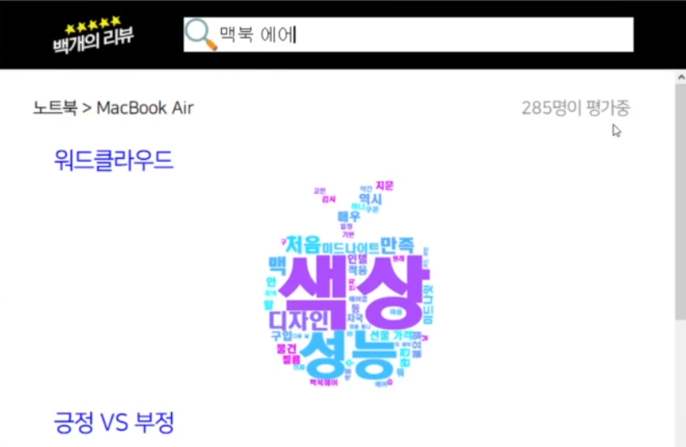
05. Database Workloads
OLAP
: f’SELECT r.review FROM review_table r WHERE r.condensed_name = {search}’
• When a product name is entered, the product review data is processed to enable word cloud, positive/negative classification, keyword classification, and YouTube link search

Slide 18
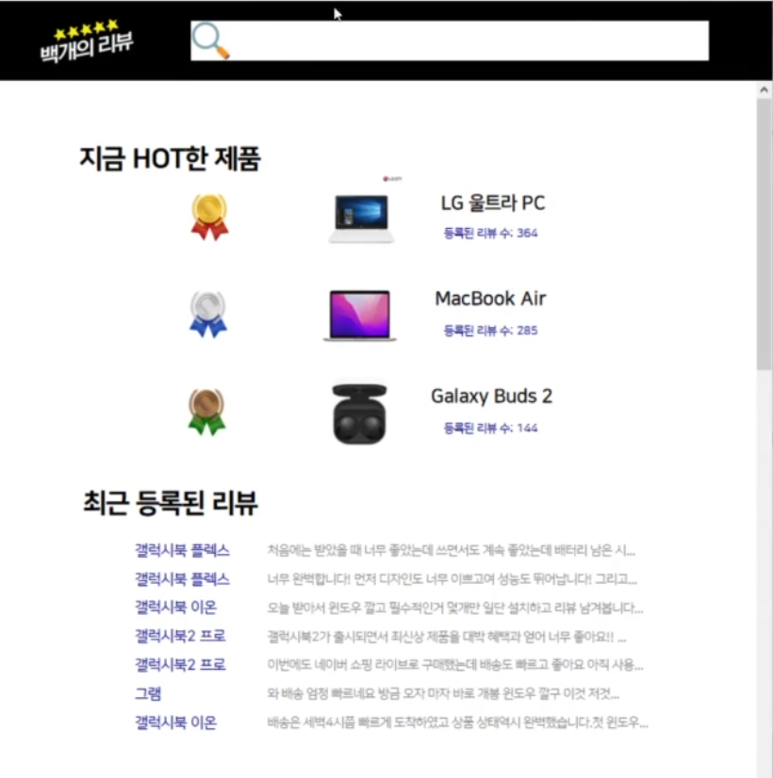
05. Database Workloads
OLAP
: SELECT r.condensed_name, r.review FROM review_table r JOIN user_table u ON u.review_id = r.review_id ORDER BY u.datetime DESC LIMIT 7
• View the 7 most recently written reviews

Slide 19
05. Database Workloads
OLAP
: SELECT r.condensed_name, p.product_image_link, COUNT(r.review_id) AS rcnt FROM review_table r JOIN user_table u ON u.review_id = r.review_id JOIN product_table p ON p.product_id = r.product_id GROUP BY r.condensed_name ORDER BY rcnt DESC LIMIT 3
WHERE u.datetime > (Last day of Last month)
• View the product names, images, and the number of registered reviews for the top three products with the highest number of reviews in the last month

Slide 20
Data Modeling

Slide 21

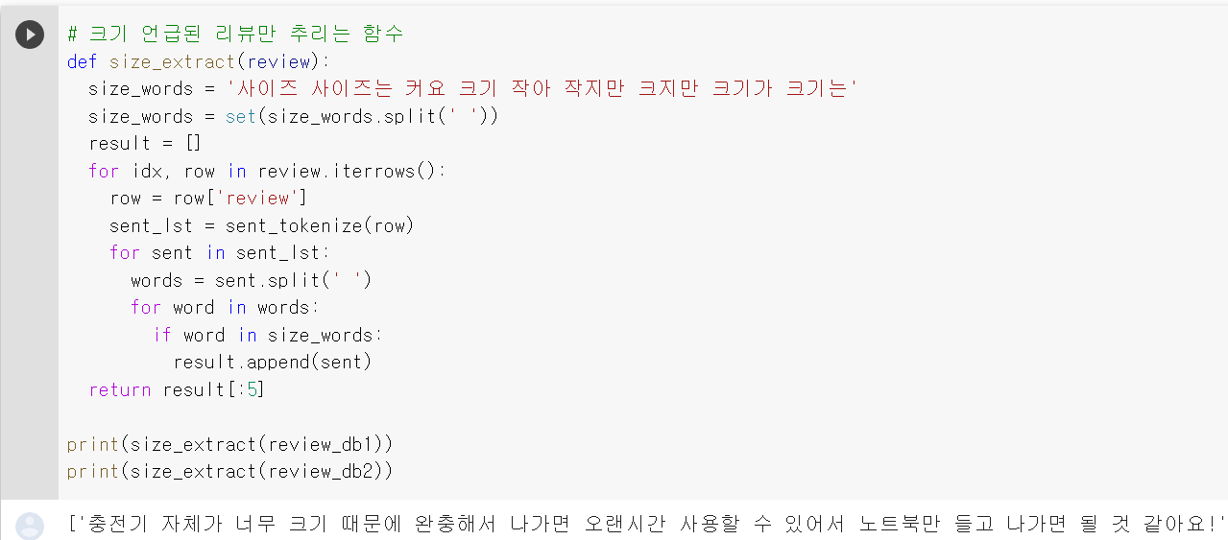
06. Data Modeling
Keyword Classification
😎
• Explore the data to select only those reviews that mention color, size, and price within the sentence after a sentence-by-sentence tokenization of the Natural Language Toolkit (NLTK) package

Slide 22
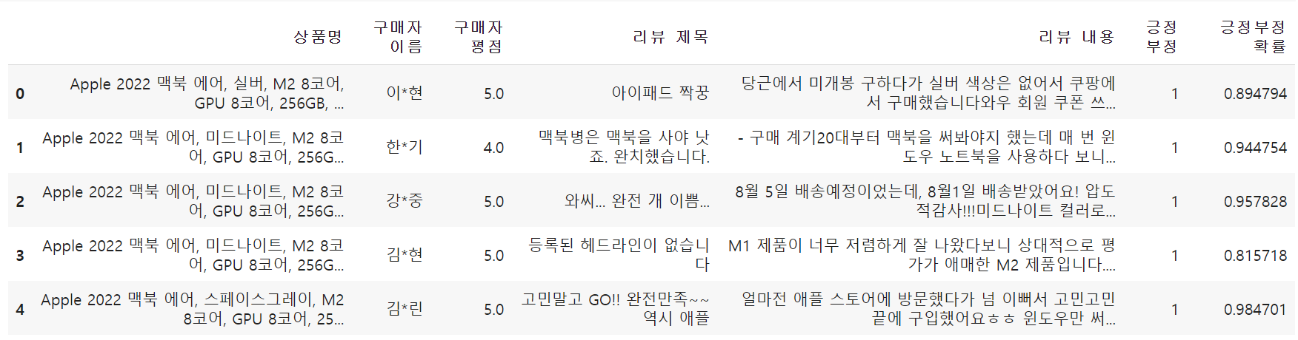
06. Data Modeling
😡
Sentiment analysis
• Data is preprocessed through the process of removing all but Korean alphabet using regular expressions.
• Use the morpheme analyzer Mecab to perform tokenization.
• The frequency of each word is calculated under two cases: which words appear mainly in positive reviews and which words appear mainly in negative reviews.
• The data then get integer encoded and classified using LSTM.

Slide 23

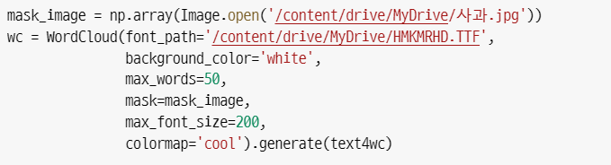
06. Data Modeling
🤖
WordCloud
• WordCloud visualizes and shows the size of most frequently appearing words in relative sizes, providing an intuitive glimpse of the most commonly used words.
• KoNLPy (package for natural Korean language processing) was used for Korean text analysis.
• Use repetitive sentences to classify shapes and match parts

Slide 24
DEMO

Slide 25
Limitation

Slide 26
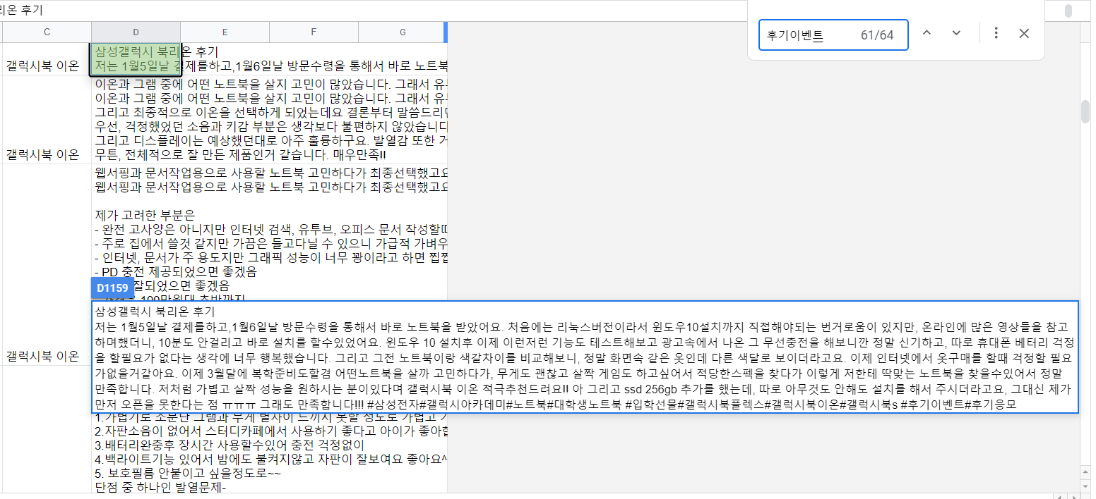
07. Limitation
Difficult to identify advertised reviews
• Inauthentic reviews such as advertised reviews are extracted using keywords such as events and sponsorships.
• The more review data directly input by service users accumulate, the lower the proportion of advertising and event reviews
• However, in case of reviews that are not as obvious as advertising articles, it is necessary to build a sophisticated model using ML/DL because the intention and tone of the writing must be comprehensively considered.

Slide 27
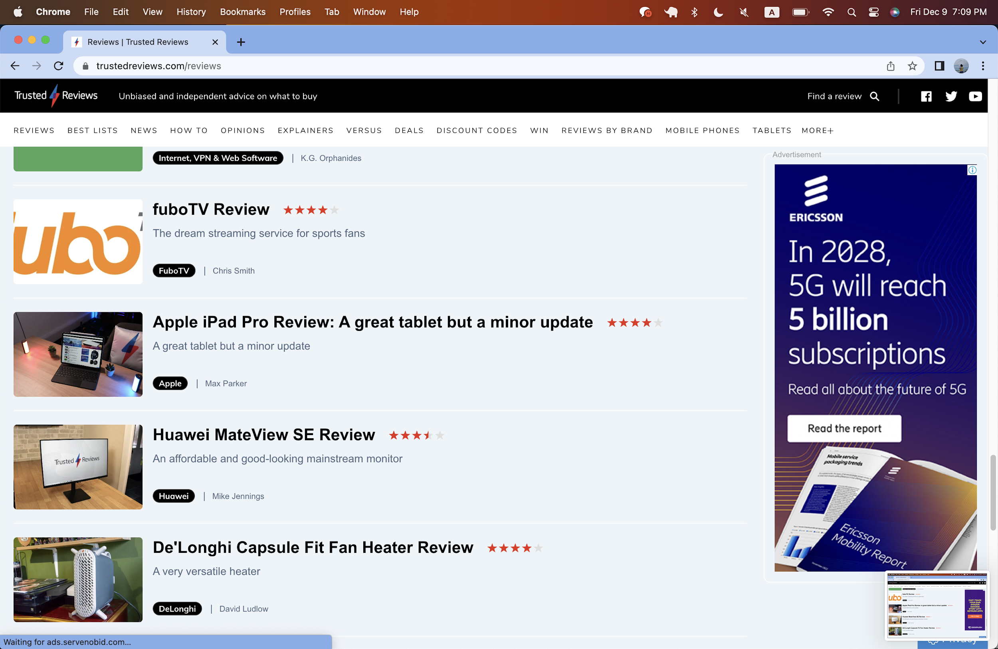
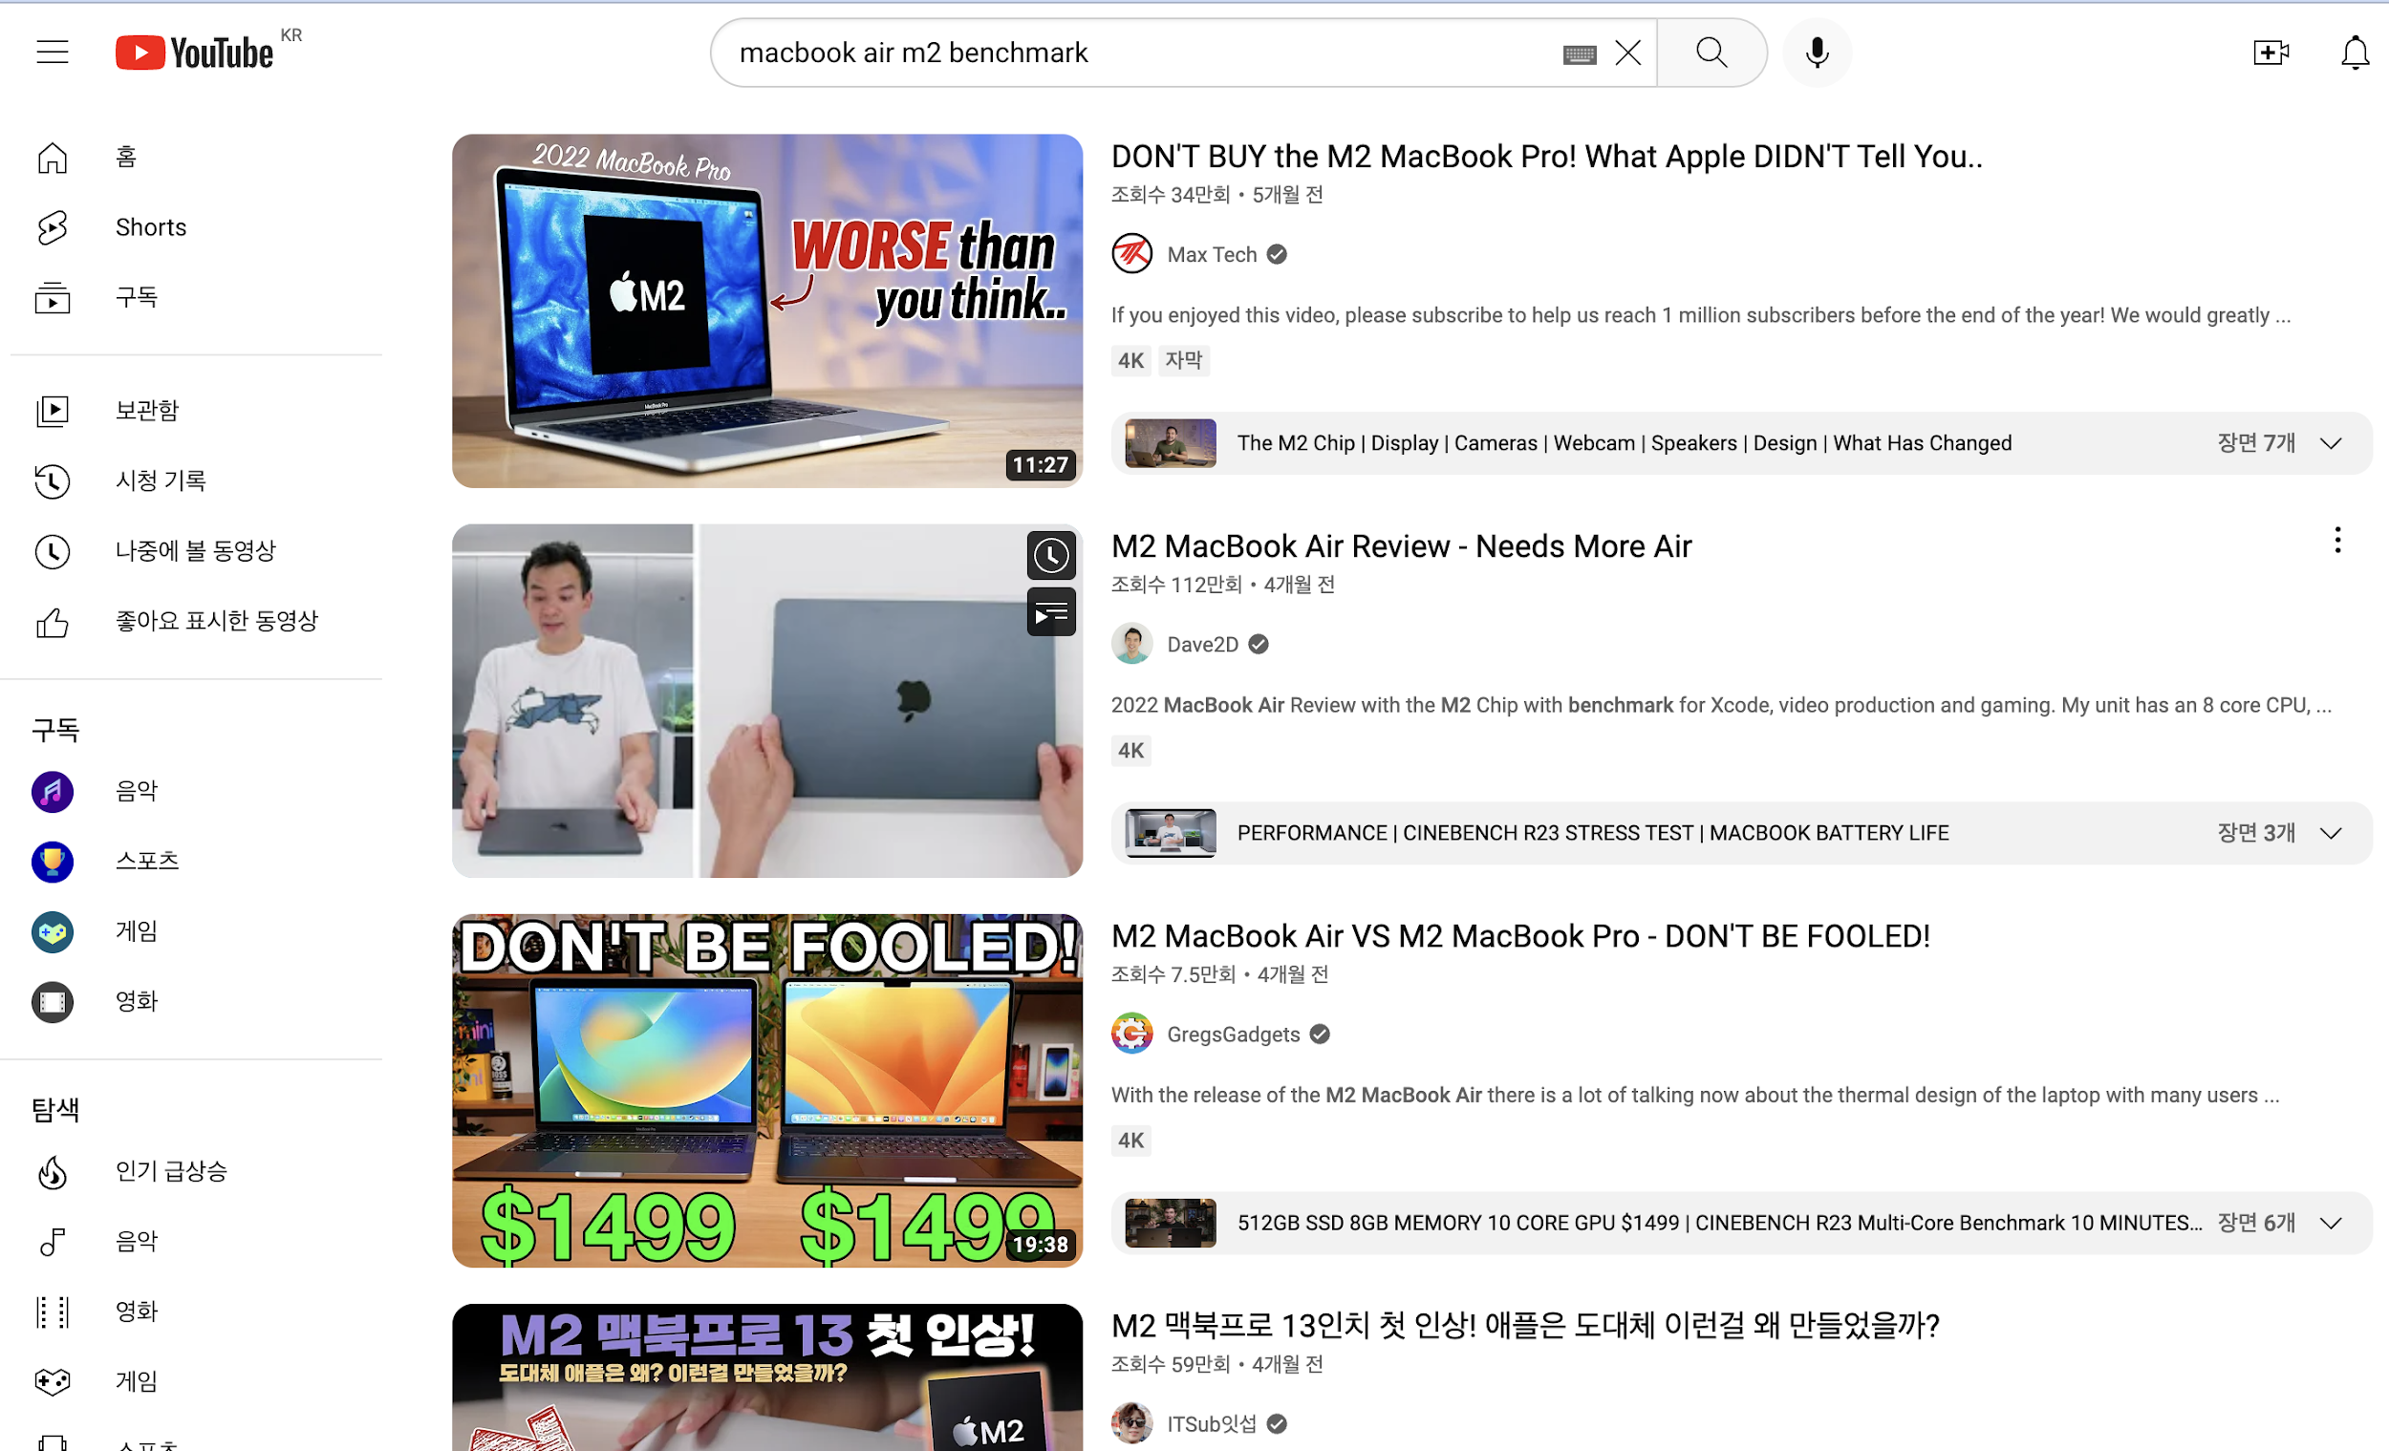
07. Limitation
Only Korean Reviews
• IT reviews are written in various languages around the world, and products sold first in other countries such as the United States may deliver more accurate results.

Slide 28
Reflection

Slide 29
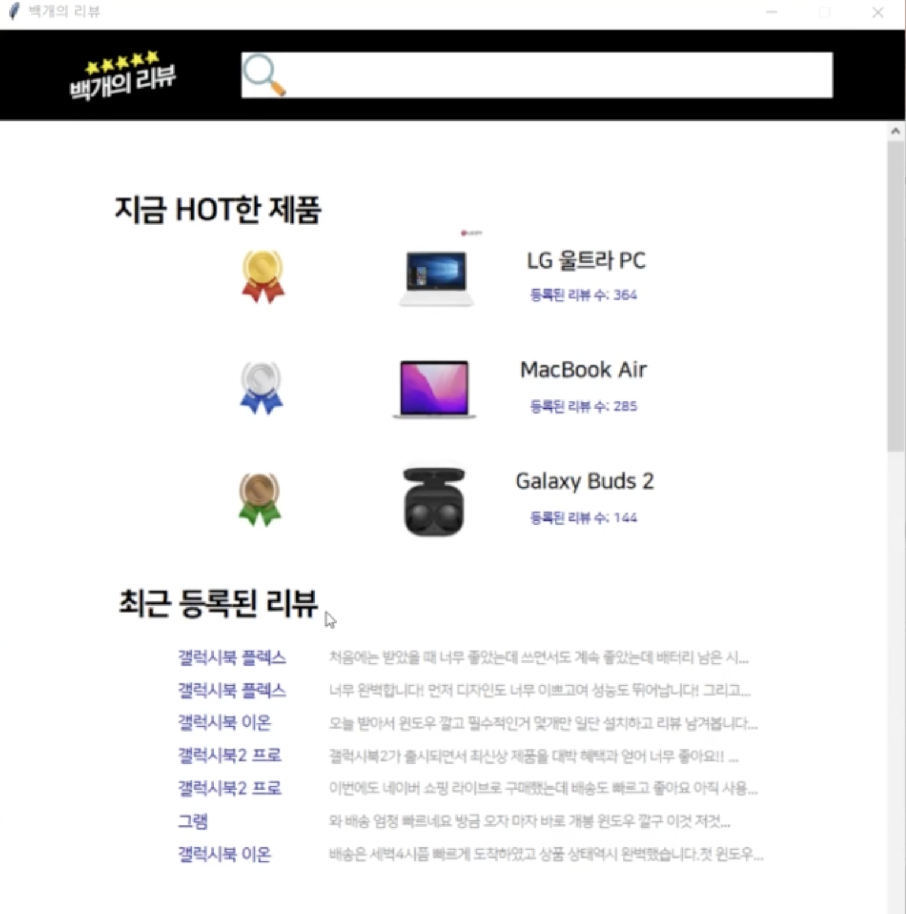
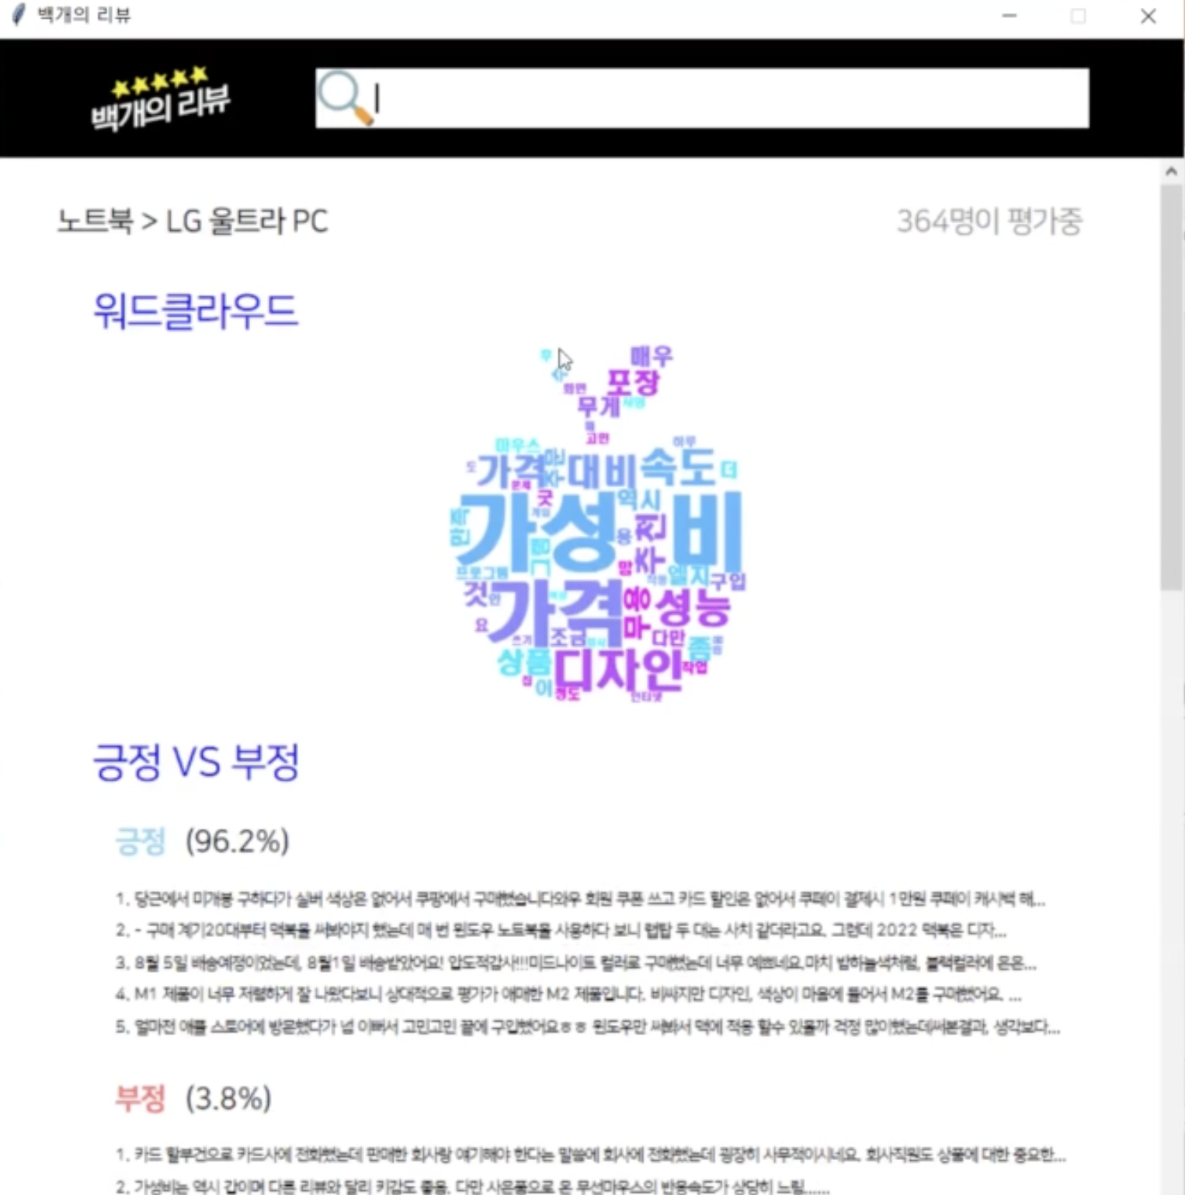
08. Reflection
Review everywhere everything all at once
We integrated reviews of massive online platforms such as Coupang and Naver Shopping where consumers purchase a lot of IT products, but missed other minor platforms.
We can also analyze high-quality reviews of IT review sites and small shopping sites such as student welfare stores.

Slide 30
Future work / Possible extensions

Slide 31
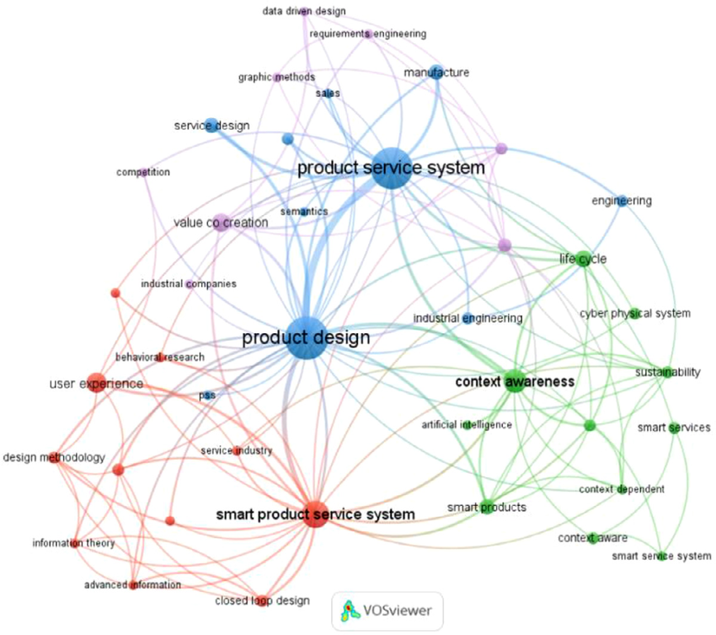
9. Future work / Possible Extensions
Using Graph database to capture keyword-product relationships and to use it to determine inauthentic reviews such as advertisement reviews.
Not just the review content itself, but also a further analysis of the star ratings given by each review could also add a dimension to the service.
Further expansion of the Database (i.e. add more products other than the electronic ones we chose)

Slide 32
Team 9

Slide 33
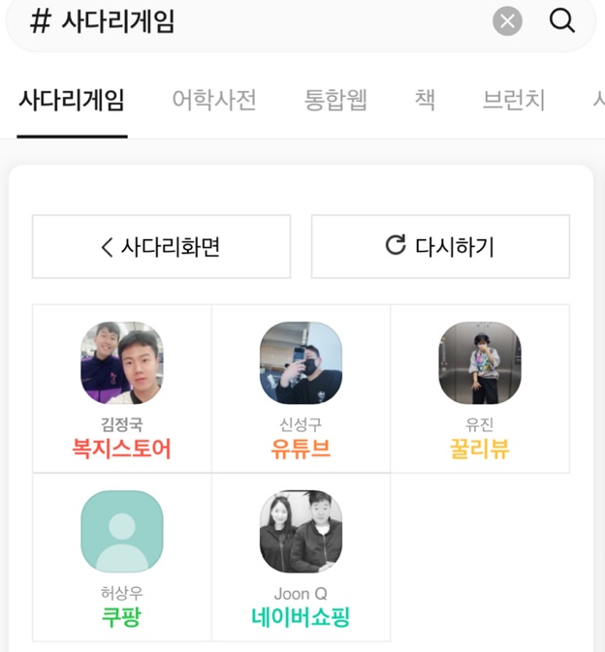
10. Team 9 members
1. Seonggu Shin - Data Science Master’s
-Leader of the team
-Project proposal, Final Presentation
-Demo development
2. Joonkyu Lee - Data Science Master’s
-Web Scraping(Naver shopping)
-MySQL Database construction
3. Jeongguk Kim - Data Science Master’s -Web Scraping(Coupang, Student Welfare Store)
-WordCloud Visualization
-Co-Produce presentation materials
4. Yujin Jo - Data Science Master’s
-Web Scraping(Ggul review)
-Sentiment analysis
-Co-Produce presentation materials
5. Sangwoo Heo - Data Science Master’s
-Web Scraping(Coupang)
-Designing OLTP/OLAP Scenarios, SQL Query
-Keyword Extraction & Classification

Slide 34
Thank you!

